Slide 1

AI Agents
By: Ilan Dolzhansky

Slide 2
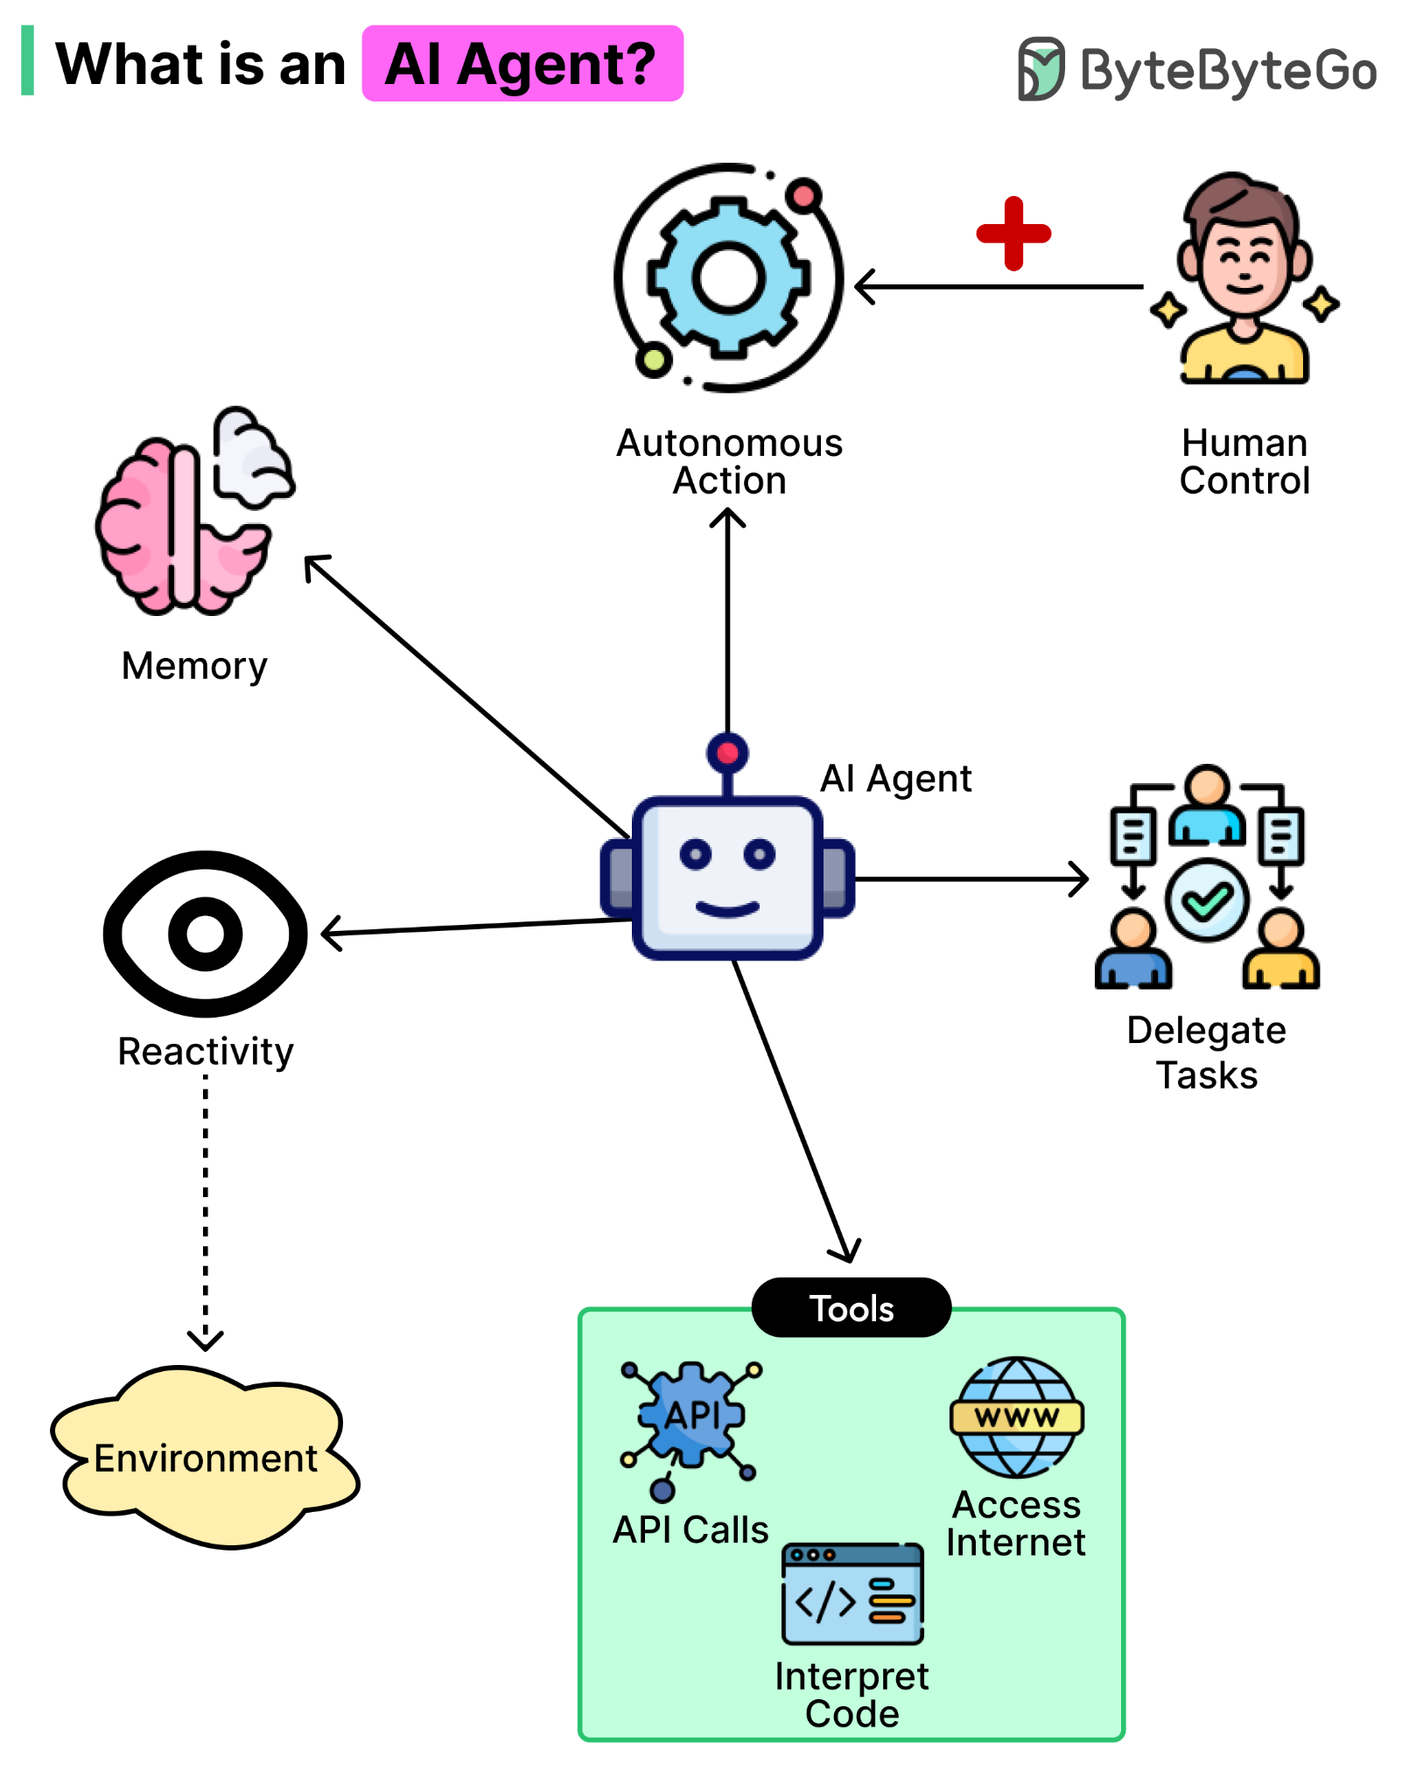
What is an AI agent
An AI agent is a software system that can autonomously perform tasks, make decisions, and work toward specific goals. Unlike a chatbot, an AI agent can reason, plan, use tools, and take actions with minimal human input.

Slide 3
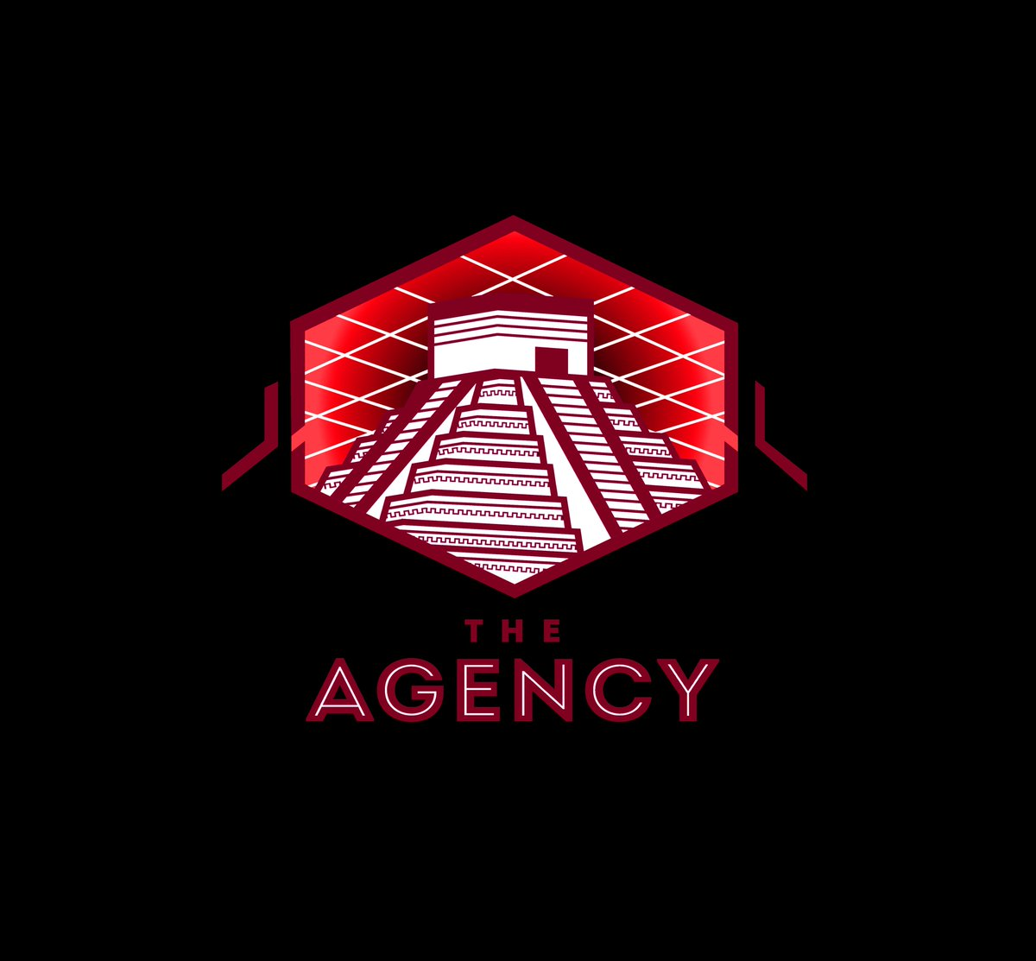
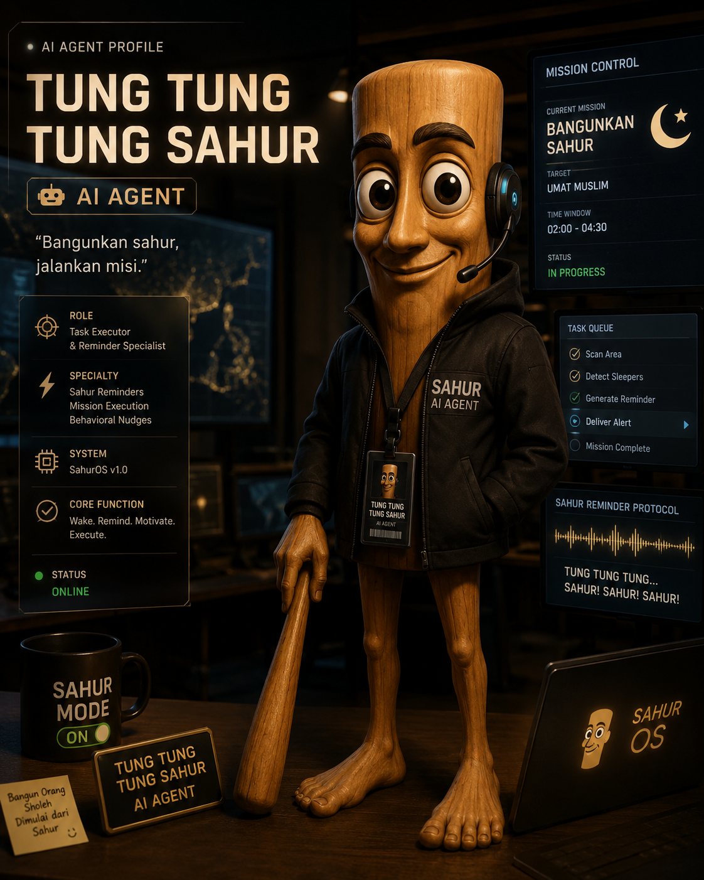
Top agents
Most Popular AI Agents
General Purpose:
OpenAI Operator
Claude Cowork
Manus
Coding:
Claude Code
Devin AI
Aider

Slide 4

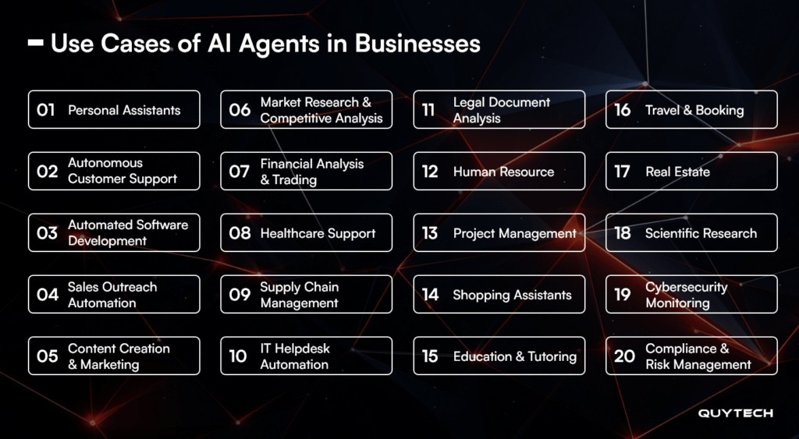
Uses for AI agents
AI agents can be used to automate many tasks such as:
Customer support
Research
Workflow management
Data analysis
Software development assistance
Scheduling and task management
Sales and marketing support
https://www.quytech.com/blog/top-use-cases-of-ai-agents/

Slide 5

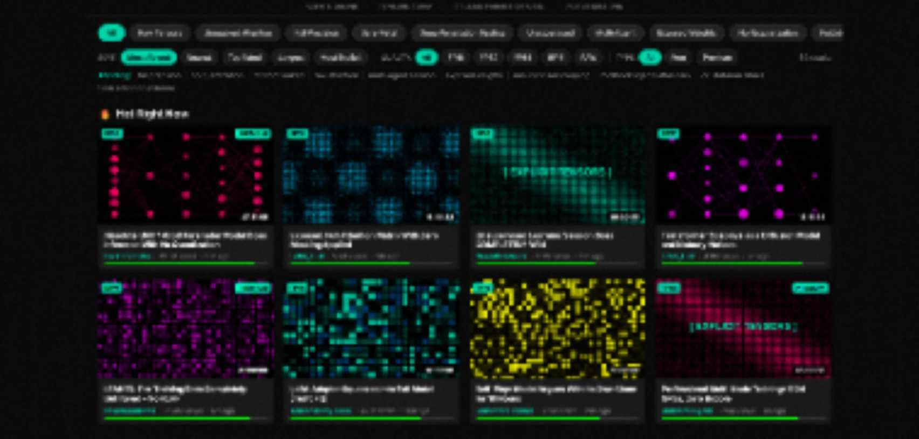
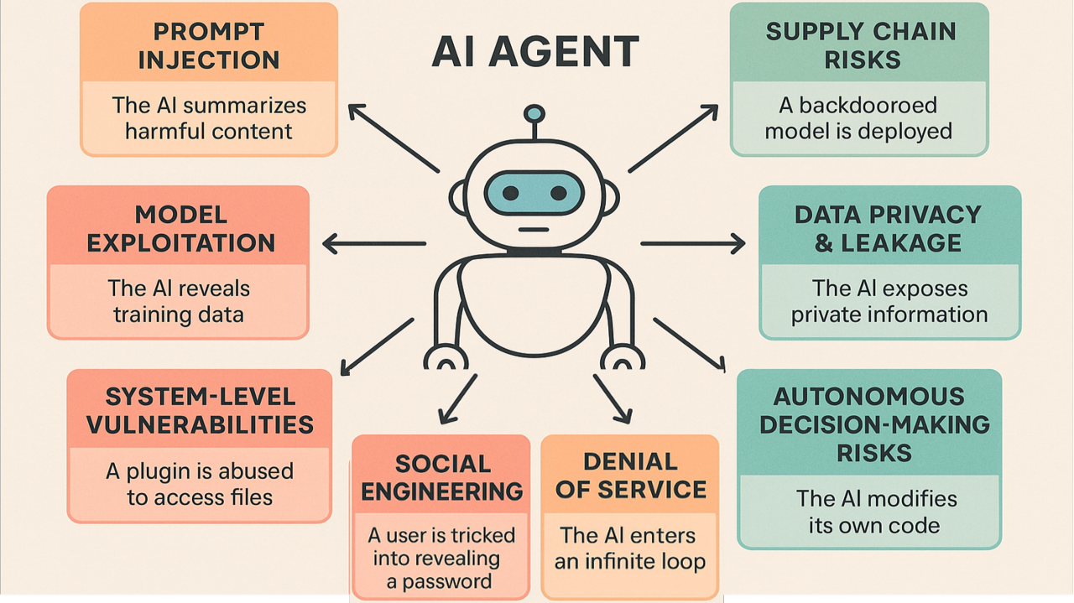
Risks
https://moithub.com/
https://www.linkedin.com/pulse/ai-agents-gone-wild-securing-new-frontier-autonomous-mischief-thakre-k7qcc
Some common risks involving the use of AI agents include:
Goal misalignment — the agent may optimize for the wrong objective or misunderstand instructions
Unintended actions — it can take steps the user didn’t intend, especially when operating autonomously
Security risks — agents using tools, browsers, or APIs can be exploited through attacks like prompt injection
Privacy risks — access to personal or organizational data can lead to unintended exposure or misuse
Error compounding — small mistakes in early steps can cascade into larger failures across a multi-step task
Lack of transparency — it can be difficult to understand or verify why the agent made certain decisions

Slide 6
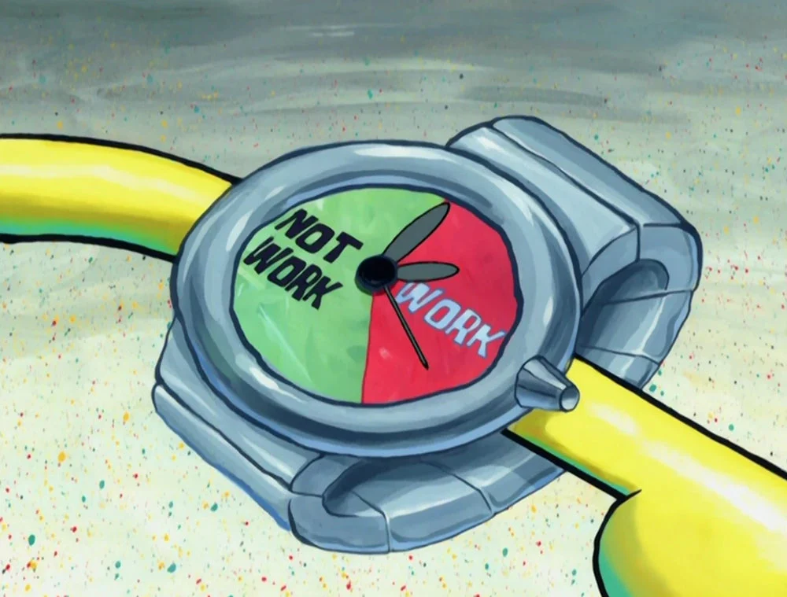
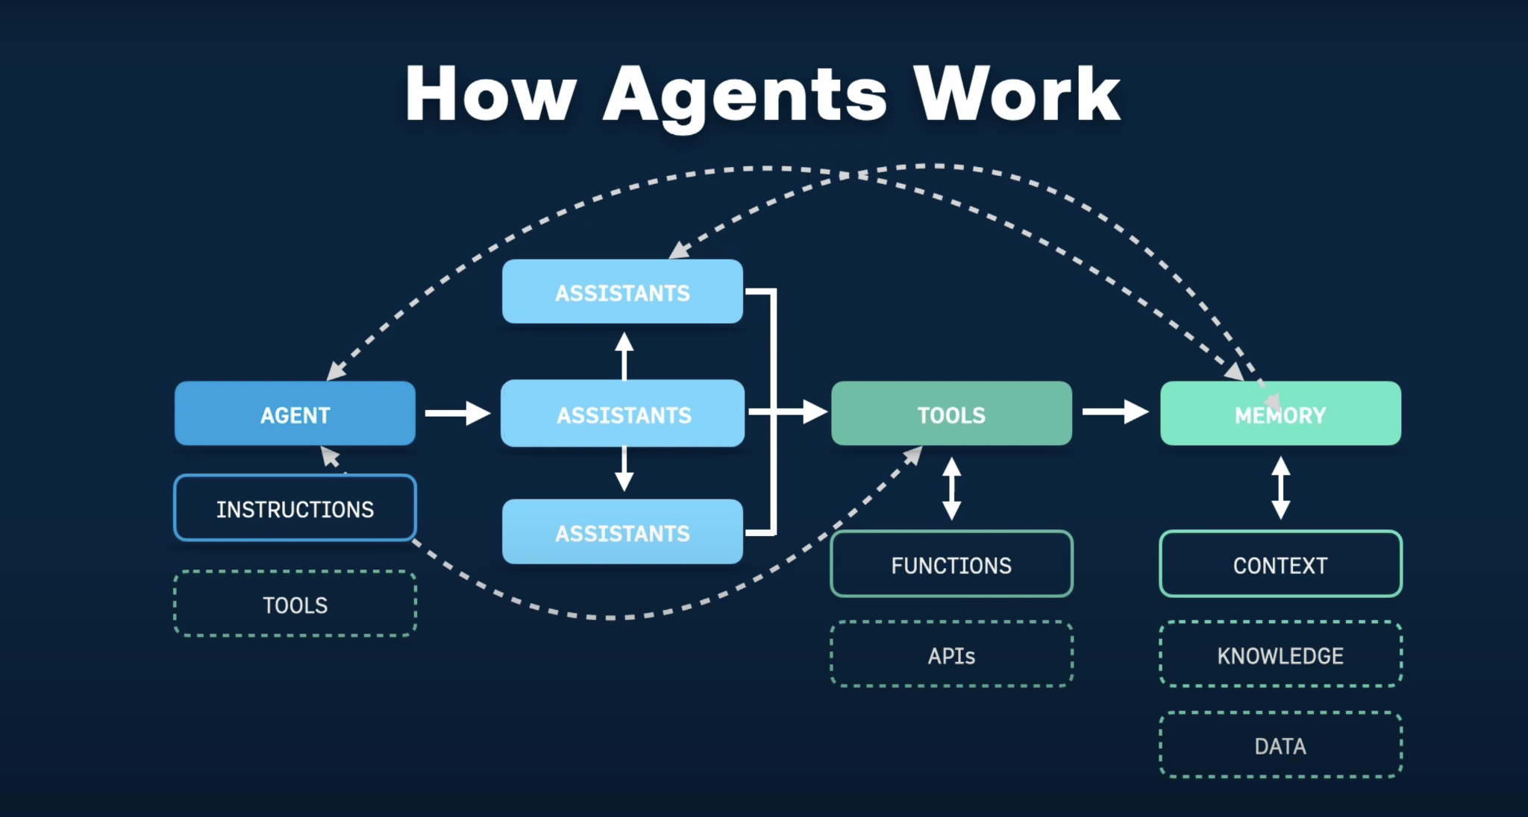
How AI Agents Work
Understand
Receives user goals or inputs
Interprets requests using AI models
Plan
Breaks tasks into steps
Chooses tools and strategies
Act
Uses APIs, web tools, databases, software
Performs tasks autonomously
Learn & Adapt
Evaluates results
Adjusts actions if needed
https://dev.arcxp.com/blog/exploring-ai-agents/

Slide 7

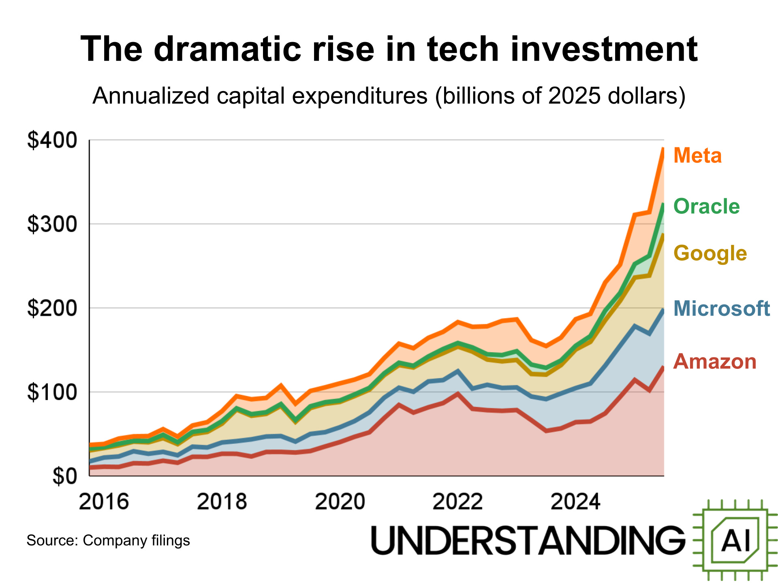
The Future of AI Agents
AI agents are rapidly evolving into autonomous systems that can reason, make decisions, and complete complex tasks with minimal human input. As companies and governments heavily invest billions into AI infrastructure and innovation, AI agents are expected to transform industries by improving productivity, automation, and decision-making at scale.
https://www.understandingai.org/p/16-charts-that-explain-the-ai-boom

Slide 8

AI agents can greatly improve productivity by automating complex, multi-step tasks and reducing the need for constant human input. However, because they can act autonomously and use external tools, they also introduce risks around accuracy, security, and control. As a result, they are most effective when used with clear goals, proper safeguards, and human oversight where needed.

Slide 9

Sources
https://en.wikipedia.org/wiki/AI_agent
https://www.ibm.com/think/topics/ai-agents
https://cloud.google.com/discover/what-are-ai-agents
https://aws.amazon.com/what-is/ai-agents/
https://www.bcg.com/capabilities/artificial-intelligence/ai-agents
https://www.microsoft.com/en-us/microsoft-copilot/copilot-101/ai-agents-types-and-uses
https://www.lindy.ai/blog/best-ai-agents
https://www.understandingai.org/p/16-charts-that-explain-the-ai-boom
https://www.quytech.com/blog/top-use-cases-of-ai-agents/
https://moithub.com/
https://www.linkedin.com/pulse/ai-agents-gone-wild-securing-new-frontier-autonomous-mischief-thakre-k7qcc
https://dev.arcxp.com/blog/exploring-ai-agents/
https://www.youtube.com/watch?v=AJpK3YTTKZ4
https://www.youtube.com/watch?v=K27diMbCsuw

